Slide 1


SMART BOOK RECOMMENDATION SYSTEM
CB.SC.U4AIE24103-Ananya
CB.SC.U4AIE24119-Kiranmai
CB.SC.U4AIE24120-Sudeshna
CB.SC.U4AIE24163-Devisri

Slide 2

INTRODUCTION
The Smart Book Recommendation System (SBRS) leverages Artificial Intelligence (AI) and deep learning techniques to suggest books based on user preferences. Using a hybrid recommendation approach, the system integrates Singular Value Decomposition (SVD), deep learning model (GRU). A Flask-based web application provides an interactive interface for users to receive personalized book recommendations, while librarians can analyze book demand. The system is scalable and adaptable to real-world library management.

Slide 3
OBJECTIVES:
Provide Personalized Recommendations using a hybrid approach combining Collaborative Filtering (SVD) and Gated Recurrent Unit(GRU).
Develop a User-Friendly Web Interface using Flask for seamless user interaction and book suggestions.
3.Ensure System Scalability to adapt to growing datasets and evolving user preferences.

Slide 4
LITERATURE REVIEW
Book Recommendation System for Digital Library Based on User Profiles by Using Association Rule | Proposed a digital library recommender using association rule mining based on user borrowing behavior. Addressed the cold-start problem in collaborative filtering. Highlighted the importance of user profiles for effective book suggestions. Relevance: Emphasized the value of historical data and implicit behavior in recommendations, which complements our SVD module.
Book Recommendation System through Content Based and Collaborative Filtering Method | Developed a hybrid recommendation system combining content-based filtering (CBF), collaborative filtering (CF), and association rule mining. Aimed to reduce irrelevant suggestions and improve recommendation quality. Introduced ECLAT algorithm for efficient pattern discovery. Relevance: Validates the approach of integrating multiple filtering methods for improved performance, as done with SVD and GRU in our system.
Book Recommendation System Based on Combine Features of Content Based Filtering, Collaborative Filtering and Association Rule Mining | Proposed a recommender that integrates Web Usage Mining, Collaborative Filtering, and Content Filtering. Employed cosine similarity and weighted averaging in collaborative filtering. Demonstrated how blending methods enhances both accuracy and user engagement. Relevance: Strongly supports the concept of hybrid models, especially the combined analysis of book content and user ratings, as implemented in our GRU + SVD architecture.

Slide 5

METHODOLOGY

Slide 6
Collaborative Filtering(SVD):
Step 1: Data Preparation - Encoded User_ID and Book_ID as categorical codes. - Constructed a user-book rating matrix using normalized ratings.
Step 2: Mean Imputation - For missing ratings, computed and filled the column-wise average (book-based mean) to reduce sparsity.
Step 3: Applying SVD (Singular Value Decomposition)
Decomposed the rating matrix into 3 components: - U (user features), Σ (sigma) (singular values), Vᵗ (book features).
Reconstructed the matrix with reduced dimensions to predict unknown ratings.
Step 4: Evaluation - Predicted ratings on test data using the reconstructed matrix.

Slide 7
Content Based Filtering(GRU):
Step 1: Text Feature Extraction
Merged Book Title and Book Genre into a single string per book.
Used Tokenizer to convert text into sequences.
Applied padding to standardize input length .
Step 2: Model Architecture (GRU)
Used Bidirectional GRU layers to process sequential text data.
Included:
Embedding Layer (for word vector representation)
Batch Normalization and Dropout (for regularization)
Dense Output Layer predicting popularity score.
Step 3: Training
Trained the GRU model on 80% of the dataset (with validation on 20%).
Ran for 150 epochs using MSE loss and Adam optimizer.
Step 4: Evaluation
Predicted popularity scores on test data.

Slide 8

IMPLEMENTATION TOOLS & LIBRARIES
Languages: Python
Libraries: Pandas, NumPy, Scikit-Learn, TensorFlow, Keras
Models Used:
SVD (Singular Value Decomposition) – Collaborative Filtering
GRU (Gated Recurrent Units) – Deep Learning (Text Analysis)
Data Source: Excel-based simulated book and rating dataset

Slide 9
SVD MODEL IMPLEMENTATION
Collaborative filtering using latent features.
Handles personalized recommendations based on collective behavior.
Evaluation on test data:
MAE (Mean Absolute Error): 0.3498
RMSE (Root Mean Squared Error): 0.4199
Accuracy (±0.5 threshold): 77.55%
GRU MODEL IMPLEMENTATION
NLP-based content model trained on textual book features.
GRU network predicts popularity score from text.
Deep layers extract sequential patterns from text sequences.
Evaluation results:
MAE (Mean Absolute Error): 0.2316
Accuracy (±0.5 threshold): 95.00%

Slide 10
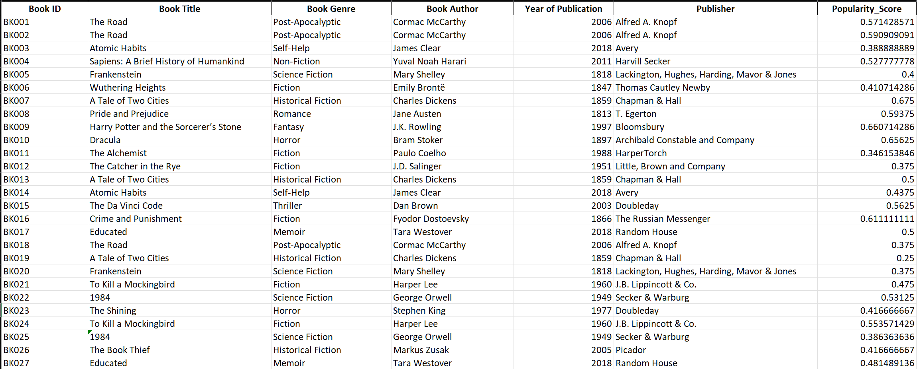
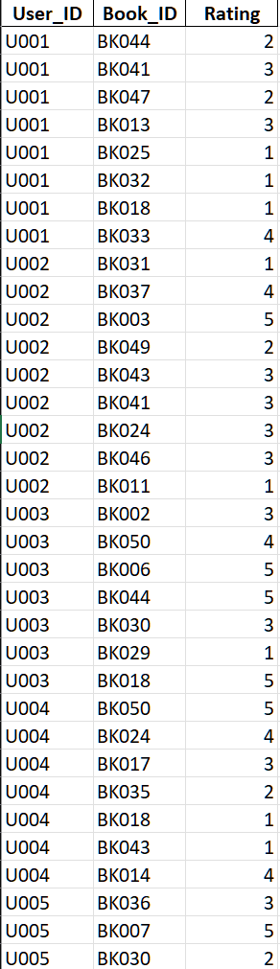
BOOKS
RATINGS

Slide 11
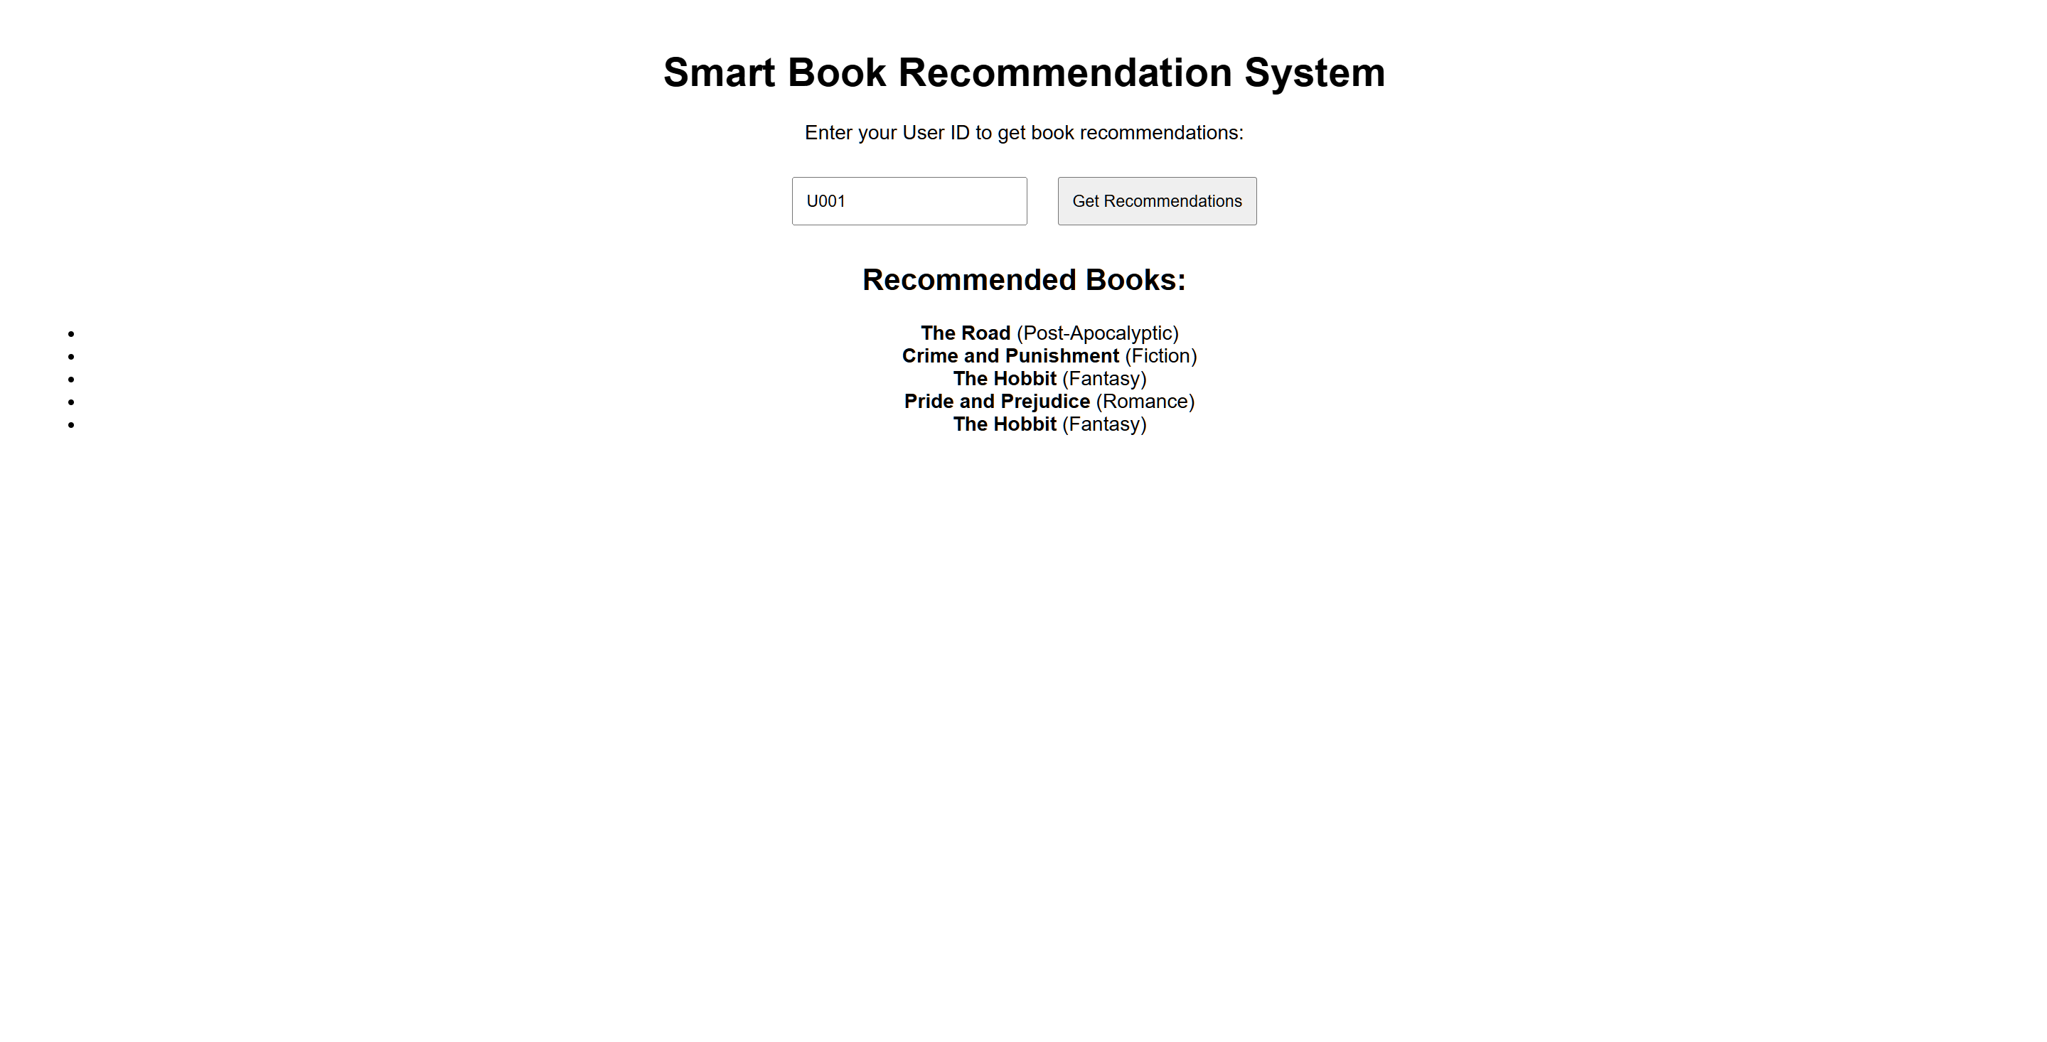
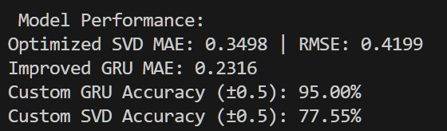
RESULTS

Slide 12
ADVANTAGES
Combines collaborative and content-based filtering.
Reduces sparsity and cold-start problems.
GRU captures sequential patterns in text effectively.
Scalable to include author, summary, or user demographics.
DISADVANTAGES
The GRU model requires high computational resources and longer training time.
SVD is ineffective for new users with no prior interaction data (cold-start problem).
The system relies heavily on the quality of book metadata for accurate predictions.
Real-time updates are not supported without retraining the models.

Slide 13
LIMITATIONS
GRU model requires long training time (150 epochs).
Cold start still affects new users.
NLP-based model depends on quality of textual data.
High computational cost for deep learning models

Slide 14
CONCLUSION
A hybrid recommender system was successfully developed combining:
SVD (Collaborative Filtering) for personalized score predictions.
GRU (Deep Learning) for understanding text-based book features.
The model demonstrated improved accuracy and user alignment.
It is an effective solution for building modern recommendation engines in libraries and digital platforms.

Slide 15
FUTURE WORK
Integrate user demographics and behavioral analytics.
Use Transformer/BERT models for deeper language
understanding.
Build a web interface or mobile app for user interaction.

Slide 16
REFERENCES
Jomsri, P. (2014). Book Recommendation System for Digital Library Using Association Rule, IEEE.
Mathew, P., Kuriakose, B., Hegde, V. Hybrid Recommender Using CF and CBF, IEEE.
Tewari, A. S., Kumar, A., Barman, A. G. Book Recommendation using Hybrid Features, IEEE IACC.

